Slide 1
OBSTACLE DETECTION USING IR SENSOR
MINIPROJECT

Slide 2
TEAM MEMBERS
C.NAGENDRA (14691A04B3)
B. NAGA RAMMOHAN (14691A04B1)
N. KAILASH PREETHAM (14691A0476)
D. NAVAKISHORE (14691A04B6)

Slide 3
Contents
Introduction
Hardware Components
Circuit Diagram & Working Principle
Software Used
Applications
Conclusion

Slide 4
Introduction
Now day’s many industries are using robots due to their high level of performance and reliability and which is a great help for human beings. The obstacle avoidance robotics is used for detecting obstacles and avoiding the collision. This is an autonomous robot. The design of obstacle avoidance robot requires the integration of many sensors according to their task.
The obstacle detection is primary requirement of this autonomous robot. The robot gets the information from surrounding area through mounted sensors on the robot. Some sensing devices used for obstacle detection like bump sensor, infrared sensor, ultrasonic sensor etc. Ultrasonic sensor is most suitable for obstacle detection and it is of low cost and has high ranging capability.

Slide 5
Hardware components
IR Sensor
Arduino
LED
DC Motor
Breadboard
Jumper Wires
Buzzer

Slide 6
IR Sensor:
An Infrared sensor is an electronic device. It can measure the heat of an object as well as detects the motion of the object.
The basic concept of an Infrared Sensor which is used as Obstacle detector is to transmit an infrared signal, this infrared signal bounces from the surface of an object and the signal is received at the infrared receiver.

Slide 7
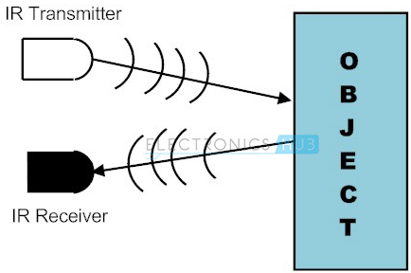
IR working principle

Slide 8
Arduino:
Arduino board designs use a variety of microprocessors and controllers. The boards are equipped with sets of digital and analog I/O pins that may be interfaced to various expansion boards(eg: GSM Module) and other circuits.
The boards feature serial communications interfaces, including Universal Serial Bus (USB) on some models, which are also used for loading programs from personal computers.

Slide 9
The microcontrollers are typically programmed using a dialect of features from the programming languages C and C++. In addition to using traditional compiler tool-chains, the Arduino project provides an integrated development environment(IDE) based on the processing language project.

Slide 10
LED
A light-emitting diode (LED) is a two-lead semiconductor light source. It is a p–n junction diode that emits light when activated. When a suitable voltage is applied to the leads, electrons are able to recombine with electron holes within the device, releasing energy in the form of photons. This effect is called electroluminescence, and the color of the light (corresponding to the energy of the photon) is determined by the energy band gap of the semiconductor.

Slide 11
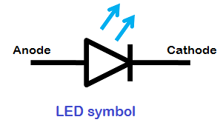
LEDs are typically small (less than 1 mm) and integrated optical components may be used to shape the radiation pattern.

Slide 12
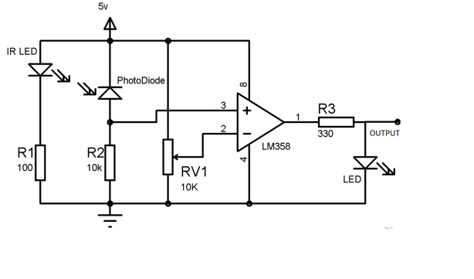
Circuit Diagram & Working Principle

Slide 13
An IR sensor consists of an IR LED and an IR Photodiode; together they are called as Photo–Coupler or Opto–Coupler. As said before, the Infrared Obstacle Sensor has built-in IR transmitter and IR receiver. Infrared Transmitter is a light emitting diode (LED) which emits infrared radiations. Hence, they are called IR LED’s. Even though an IR LED looks like a normal LED, the radiation emitted by it is invisible to the human eye.
Infrared receivers are also called as infrared sensors as they detect the radiation from an IR transmitter. IR receivers come in the form of photodiodes and phototransistors. Infrared Photodiodes are different from normal photo diodes as they detect only infrared radiation. When the IR transmitter emits radiation, it reaches the object and some of the radiation reflects back to the IR receiver. Based on the intensity of the reception by the IR receiver, the output of the sensor is defined.

Slide 14
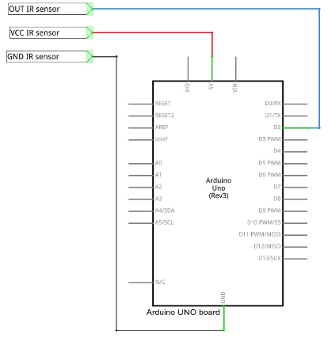
INTERFACING IR SENSOR WITH ARDUINO

Slide 15
Software used
Embedded C
There is a two level programming in which embedded c is used in controlling the hardware which produces the distance and angle measurements using servo.

Slide 16
Applications
it is used for detecting obstacles and avoiding the collision.
Especially military applications
It can be used for city wars.
This logic has been specially designed for vacuum cleaner. By using heavy rating motors ,strong mechanical structure and using highly sensitive obstacle sensors, it efficiently work as vacuum cleaner.
It can be used in mines.

Slide 17
Result
S.No | Distance(cm) | Sensor detection
1 | 2 | Yes
2 | 5 | Yes
3 | 10 | Yes
4 | 15 | No

Slide 18
Conclusion
The prototype of the project concentrates on using IR sensor to detect the nearby obstacle/human/vehicle in the range of 10cm and made the LED, the BUZZER on and makes motor to stop

